Slide 1
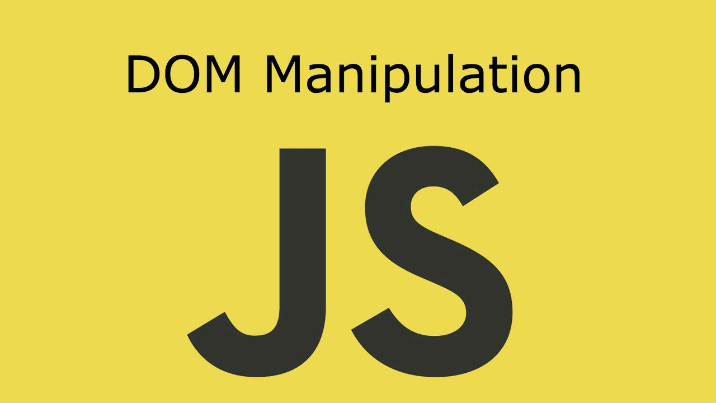
DOM Manipulations
Create / Delete DOM Elements, Handle Browser Events
SoftUni Team
Technical Trainers
Software University
https://softuni.bg

Slide 2
Table of Contents
Event Loop
Event Types
Event Object Properties and Methods
Handling Events

Slide 3
Have a Question?
sli.do #js-advanced

Slide 4

Event Loop

Slide 5
Don't Make the Thread Wait
JS is single threaded language
Blocking thread requests
Register a callback
Handle multiple concurrent operations on one thread

Slide 6
Stack Execution
The Stack
The Heap
function

Slide 7
Stack Execution
The Stack
The Heap
function
function
function
Function call
Execution returns

Slide 8
Stack Execution
The Stack
The Heap
Program finished

Slide 9
The Event Loop
The Stack
The Heap
function
function
function
Event Queue
Event placed in the queue
event

Slide 10
The Event Loop
The Stack
The Heap
Execution stack
is empty
function
function
function
Event Queue
event

Slide 11
The Event Loop
The Stack
The Heap
Event callback is executed
function
Event Queue
event

Slide 12

Handling DOM Events
DOM Events

Slide 13
Event Propagation
Window
CAPTURE
BUBBLING
Document
<HTML>
<BODY>
<HEADER>
<DIV>
<DIV>
<A>
<A>
TARGET

Slide 14
Event Types in DOM API
Mouse events
Touch events
DOM / UI events
click
mouseover mouseout mousedown
mouseup
touchstart
touchend
touchmove
touchcancel
load
unload
resize
dragstart / drop
Keyboard events
Focus events
Form events
keydown
Keypress
keyup
input
change
submit
reset
focus (got focus)
blur (lost focus)

Slide 15
Event Object
Calls its associated function
Passes a single argument to the function - a reference to the event object
Contains a number of properties that describe the event that occurred

Slide 16
Event Object Properties and Methods
Properties
target
timeStamp
isTrusted
clientX/Y
Methods
preventDefault
stopPropagation
stopImmediatePropagation

Slide 17
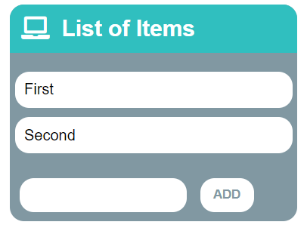
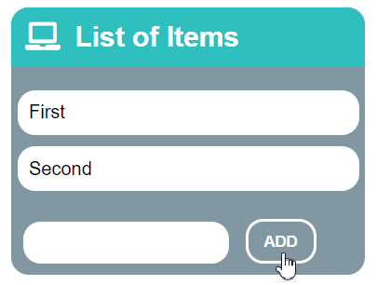
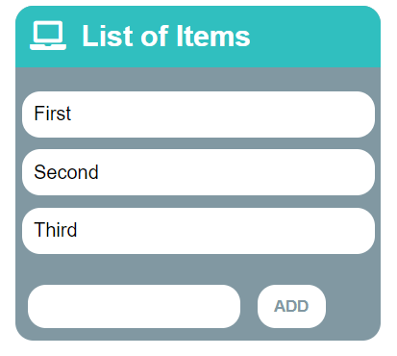
Problem: List of Items
Create a HTML page holding a list of items + text box + button for adding more items to the list
Write a function to append the specified text to the list

Slide 18
Problem: List of Items – HTML
<h1>List of Items</h1>
<ul id="items"><li>First</li><li>Second</li></ul>
<input type="text" id="newItemText" />
<input type="button" value="Add" onclick="addItem()">
<script>
function addItem() {
// TODO: Add new item to the list
}
</script>

Slide 19
Solution: List of Items
function addItem() {
let text = document.getElementById('newItemText').value;
let li = document.createElement("li");
li.appendChild(document.createTextNode(text));
document.getElementById("items").appendChild(li);
//clearing the input:
document.getElementById('newItemText').value = '';
}
Check your solution here: https://judge.softuni.bg/Contests/Practice/Index/1549#0

Slide 20

Event Handling

Slide 21
Event Handler
Event registration is done by providing a callback function
Three ways to register for an event:
With HTML Attributes
Using DOM element properties
Using DOM event handler
function handler(event){ // this --> object, html reference
// event --> object, event configuration }

Slide 22

Event Listener
addEventListener();
removeEventListener();
htmlRef.addEventListener( 'click' , handler , false );
htmlRef.removeEventListener( 'click' , handler);

Slide 23
Attaching Click Event
const button = document.getElementsByTagName('button')[0];
button.addEventListener('click', clickMe);
function clickMe(e) {
const target = e.currentTarget;
const targetText = target.textContent;
target.textContent = Number(targetText) + 1;
}

Slide 24
Attaching Hover Event
const button = document.getElementsByTagName('div')[0];
button.addEventListener('mouseover', function (e) {
const style = e.currentTarget;
const { backgroundColor } = style;
if(backgroundColor === 'white'){
targetStyles.backgroundColor = '#234465';
targetStyles.color = 'white';
} else {
targetStyles.backgroundColor = 'white';
targetStyles.color = '#234465';
}}
);

Slide 25
Attaching Input Event
const inputField = document.getElementsByTagName('input')[0];
const button = document.getElementsByTagName('button')[0];
inputField.addEventListener('input', function () {
button.setAttribute('disabled', 'false')
});

Slide 26
Remove Events
const password = document.querySelector('input[type="password"]');
const button = document.querySelector('button');
password.addEventListener('focus', focusEvent);
function focusEvent (){
event.target.style.background = '#234465';
}
password.addEventListener('blur', (event) => {
event.target.style.background = '';
});
button.addEventListener('click', () => {
password.removeEventListener('focus', focusEvent);
});

Slide 27
Multiple Events
The addEventListener() method also allows you to add many events to the same element, without overwriting existing events:
Note that you don't use the "on" prefix for the event use "click" instead of "onclick"
element.addEventListener("click", function);
element.addEventListener("click", myFunction);
element.addEventListener("mouseover", mySecondFunction);
element.addEventListener("mouseout", myThirdFunction);

Slide 28

SetInterval() / ClearInterval()
In JS we can start / stop timers (intervals)
Remove (cancel) existing timer
let intervalID = setInterval(
function() {
console.log("1 sec. passed");
},
1000
); // Delay = 1000 ms = 1 second
clearInterval(intervalID); // Stop the timer

Slide 29
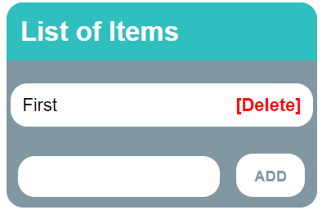
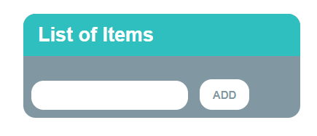
Problem: 2. Add / Delete Items
Extend the previous problem
Implement [Delete] action as link after each list item
Check your solution here: https://judge.softuni.bg/Contests/Practice/Index/1549#1

Slide 30
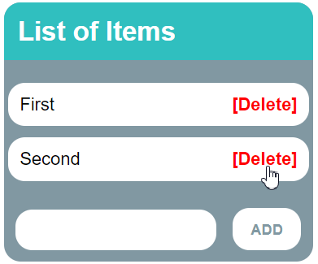
Problem: 2. Add / Delete Items – HTML
<h1>List of Items</h1>
<ul id="items"></ul>
<input type="text" id="newText" />
<input type="button" value="Add" onclick="solve()">
<script>
function solve() { // TODO...
}
</script>

Slide 31
Solution: 2. Add / Delete Items
function solve() {
let newElement = document.getElementById("newText").value;
let list = document.getElementById("items");
if (newElement.length === 0) return;
let listItem = document.createElement("li");
listItem.textContent = newElement;
let remove = document.createElement("a");
let linkText = document.createTextNode("[Delete]");
// Continued on the next slide ...

Slide 32
Solution: 2. Add / Delete Items
remove.appendChild(linkText);
remove.href = "#";
remove.addEventListener("click", deleteItem);
listItem.appendChild(remove);
list.appendChild(listItem);
function deleteItem() {
listItem.remove();
}
}

Slide 33

Event Delegation

Slide 34
DOM Event Delegation
Allows you to avoid adding event listeners to specific nodes
Event listener is assigned to a single ancestor
<ul id="parent-list">
<li id="post-1">Item 1</li>
<li id="post-2">Item 2</li>
</ul>
document.getElementById("parent-list")
.addEventListener("click", function(e) {
if(e.target && e.target.nodeName == "LI") {
console.log(
"List item ", e.target.id.replace("post-", ""),
" was clicked!");
}
});

Slide 35
Pros and Cons
Benefits
Simplifies initialization
Saves memory
Less code
Limitations
Event must be bubbling
May add CPU load

Slide 36

Live Exercises

Slide 37
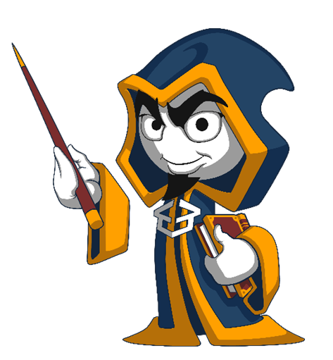
Summary
Arrow functions ≈ short function syntax
Event Loop
Event Types
Event Object Properties and Methods
preventDefault
stopPropagation
Handling Events
Attach
Remove

Slide 38
Questions?
Notes:
38

Slide 39
Trainings @ Software University (SoftUni)
Software University – High-Quality Education, Profession and Job for Software Developers
softuni.bg
Software University Foundation
softuni.foundation
Software University @ Facebook
facebook.com/SoftwareUniversity
Software University Forums
forum.softuni.bg
Notes:
39

Slide 40

License
This course (slides, examples, demos, exercises, homework, documents, videos and other assets) is copyrighted content
Unauthorized copy, reproduction or use is illegal
© SoftUni – https://about.softuni.bg/
© Software University – https://softuni.bg
Notes:
40

